Slide 1

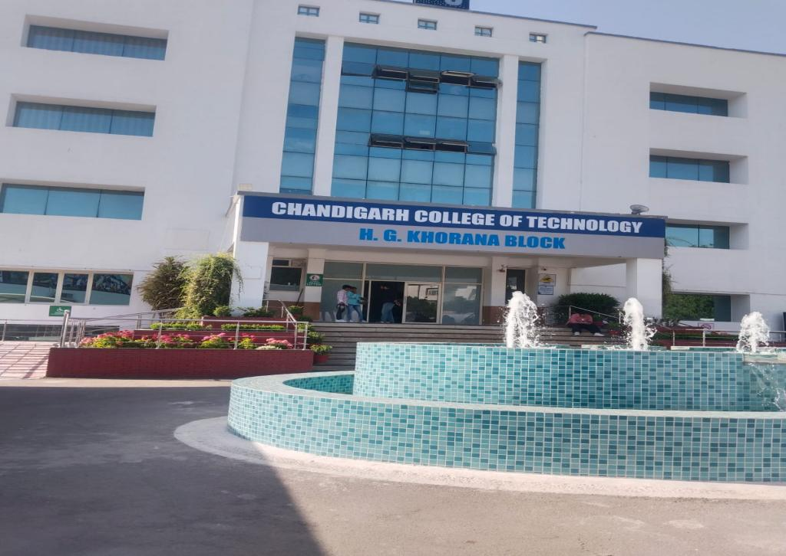

Slide 2
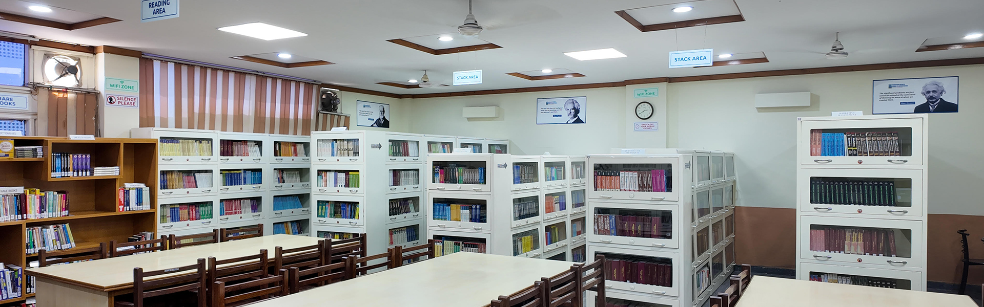
The online library provides live access to CCT LIBRARY Collection on institution website http://cgc.edu.in/. Students and Faculty can get online information about Books/CD’s/E Books/ Journals/ E journals dealing with various subjects. Library works on LIBSYS software. The library has 2 CCTV’s cameras to keep a close watch on the users to minimize the losses and mutilation of reading material.

Slide 3
LIBRARY TIMINGS
Normal Working Days
09:00 am to 4:30 pm
Examination Days
09:00 am to 6:00 pm

Slide 4
MISSION
The College Libraries are to sustain a physically and virtually appealing environment that promotes learning, teaching and research. It fosters lifelong intellectual growth and self-fulfilment by providing all users with versatile accessibility of the needed information resources. It also stimulates to promote individual sharing of ideas and love of reading and social enlightenment, enrichment throughout the knowledge society. It also supports in excellence and innovation in education and research.

Slide 5
OBJECTIVES
1) To establish a readers’ community to strengthen the goals.
2)To organize orientation programmes for users to keep them aware of the information society.
3) To promote the values and skills amongst the students.
4)To maintain a balanced and organized collection of high-quality materials and provide professional assistance to all users.
5) To provide access to information located elsewhere.
6)To educate users in developing information-gathering skills, including accessing, evaluating, and using various information sources.
7)To promote technological competence by providing access to information available in non-print formats.

Slide 6
LIBRARY AT A GLANCE
TOTAL COLLECTION OF BOOKS | 9909
NO. OF TITLES | 1389
REFERENCE & GENERAL BOOKS | 1475
RARE BOOKS | 17
PRINT JOURNALS | 25
BOUND VOLS. OF PREVIOUS YEARS | 147
NEWSPAPERS | 3
MAGAZINES | 6

Slide 7
LIBRARY STATISTICS
TOTAL MEMBERSHIP
2280
100
100
DAILY FOOTFALL
DAILY TRANSACTIONS

Slide 8
LIBRARY STAFF
NAME | DESIGNATION
RENU OBEROI | CHIEF LIBRARIAN
NASEEB KUMAR | ASSISTANT LIBRARIAN
AMANPREET SHARMA | LIBRARY RESTORER

Slide 9

COLLEGE WEBSITE http://cctmohali.org/
LIBRARY SOFTWARE
LIBSYS

Slide 10
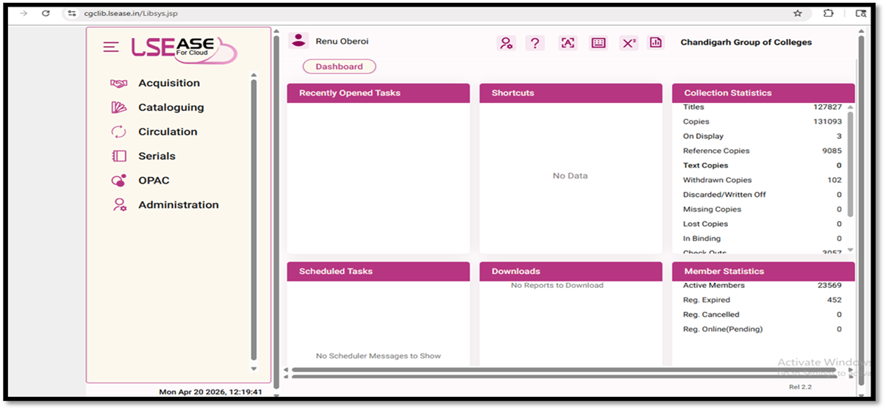
LIBRARY AUTOMATION USING INTEGRATED LIBRARY MANAGEMENT SYSTEM (ILMS)
LIBRARY SOFTWARE INTERFACE
Works on Cloud
URL : http://cgclib.lsease.in/
WEBOPAC with Remote Access
URL : http://cgcopac.lsease.in/

Slide 11
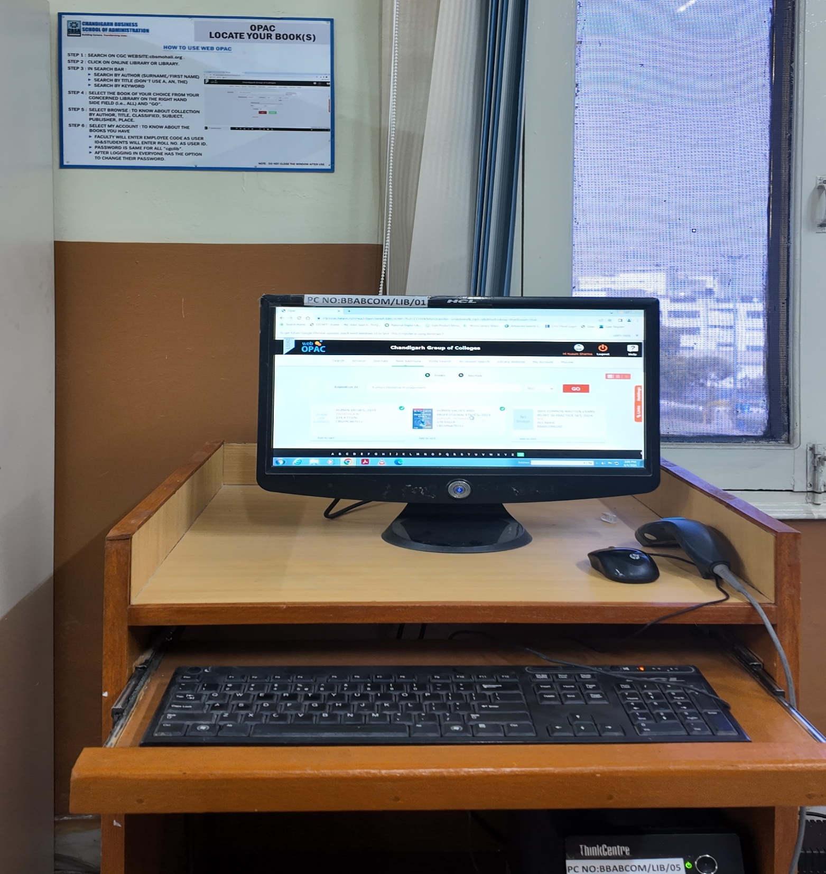
LIBRARY WEBOPAC

Slide 12
LOCATE YOUR BOOK(S)
“HOW TO USE WEB OPAC”
STEP 1 : SEARCH ON CGC WEBSITES:- www.cgc.edu.in OR cctmohali.org .
STEP 2 : CLICK ON ONLINE LIBRARY OR LIBRARY.
STEP 3 : IN THE SEARCH BAR :
SEARCH BY AUTHOR (SURNAME/FIRST NAME)
SEARCH BY TITLE (DON’T USE A, AN, THE)
SEARCH BY KEYWORD
STEP 4 : SELECT THE BOOK OF YOUR CHOICE FROM YOUR CONCERNED LIBRARY ON
THE RIGHT-HAND SIDE FIELD (i.e., ALL) AND “GO”.
STEP 5 : SELECT BROWSE: TO KNOW ABOUT COLLECTION BY AUTHOR, TITLE,
CLASSIFIED, SUBJECT, PUBLISHER, PLACE.
STEP 6 : SELECT MY ACCOUNT: TO KNOW ABOUT THE BOOKS YOU HAVE
FACULTY WILL ENTER EMPLOYEE CODE AS USER ID & STUDENTS WILL
ENTER ROLL NO. AS USER ID.
PASSWORD IS SAME FOR ALL “cgclib”.
AFTER LOGGING IN EVERYONE HAS THE OPTION TO CHANGE THEIR
PASSWORD.
NOTE : DO NOT CLOSE THE WINDOW AFTER USE

Slide 13


Slide 14

E RESOURCES
Number of e-books (WORLD E-BOOK LIBRARY) 20 Lacs+
Number of e-books (EBSCO) 2,65,000
NDL Membership E-BOOKs 45 Lacs+
Number of e-journals(DELNET) 995 e-journals(EBSCO) 2595+
Business Source Elite ( EBSCO) 1056 NPTEL VIDEO LECTURES 3621
CDs ( of Books and Magazines) 82
TURNITIN Plagiarism Software

Slide 16
E-RESOURCES --- LOGIN CREDENTIALS

Slide 17

The library has subscription of DELNET database via link http://www.delnet.in since the year 2013 and is subscribing e-journals and e-books through World e-book library via link http://database.worldlibrary.org/ and Gale journals via URL https://link.gale.com/apps/menu?u=chandigarhengg

Slide 18

EBSCO DATABASE
EBSCO resources can also be remotely accessed on EBSCO App. or on the link http://search.ebscohost.com.
It provides scholarly 3000 e-journals, working papers, reports, and datasets, and millions of digitized historical primary sources, including 2,65,000 e-books.

Slide 19
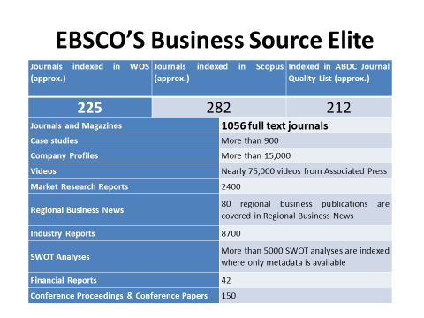

Slide 20

ANTI-PLAGIARISM SOFTWARE
To promote and support the research activities, CGC as a remedial measure has provided access to anti-plagiarism software TURNITIN since 2020.It is one such software, which is being successfully used at the global level to cross-check a vast database for identifying plagiarized portions in one’s research.

Slide 21

Lakhs of e-books can be accessed through NDL via link http://ndl.iitkgp.ac.in//.
INSTITUTIONAL NDL MEMBERSHIP NUMBER :INPBNC3ADJJC9BP

Slide 22

NPTEL Video lectures
Stream wise NPTEL
2203 video lectures can be accessed via
FTP LINK - ftp://192.168.100.14

Slide 23

Repository Links
1 e-PG Pathshala https://epgp.inflibnet.ac.in
2 e-Shodh Sindhu https://ess.inflibnet.ac.in
3 Search Engine for PDF Books www.pdfdrive.com
4 National Digital Library of India https://ndl.iitkgp.ac.in
5 ShodhGanga https://shodhganga.inflibnet.ac.in/
6 Discover scientific knowledge and stay connected to the world of science https://www.researchgate.net/
7 Free e books(60000+)https://www.gutenberg.org/
8 NPTEL [National Programme on Technology Enhanced Learning] https://nptel.ac.in
9 NPTEL Video Lectures https://archive.nptel.ac.in/

Slide 24
10 OASIS (Openly Available Sources Integrated Search) https://openlibrary.org/
11 Open access for academic books https://www.oapen.org/
12 SAKSHAT https://sakshat.ac.in/?project=vidwan
13 Science, Health, Medical and Engineering Journals www.sciencedirect.com
14 Open Access books https://www.doabooks.org/
15 SWAYAMPRABHA https://www.swayamprabha.gov.in
16 SWAYAM Online Courses https://storage.googleapis.com/uniquecourses/online.html
17 Engineering Research papers Database www.engpaper.com
18 Engineering and Applied Sciences Technology Journals www.ijeast.com
19 Enhancement in Learning with Improvement in Skills (ELIS) portal http://free.aicte-india.org/
20 DOAB - Directory of Open Access Books https://directory.doabooks.org/handle/20.500.12854/34495

Slide 25
21 DOAJ https://doaj.org/
22 e-Content courseware in UG subjects http://cec.nic.in/cec/
23 E-Kalpa https://icar.org.in/content/e-kalpa
24 Open Access Books and Journals https://about.jstor.org/librarians/books/open-access-books-jstor/
25 Free e-Books https://www.gutenberg.org/
26 AICTE Collaborations (MoU) with other Organizations https://www.aicte-india.org/education/collaborations
27 AAKASH EDUCATIONAL PORTAL https://www.it.iitb.ac.in/nmeict/home.html
28 InfoPort https:/infoport.inflibnet.ac.in
29 National Educational Alliance for Technology https//neat.aicte-india.org/
30 OAPEN https://www.oapen.org/

Slide 26
31 QUANTUM & NANO COMPUTING https://www.dei.ac.in/dei/quantumNano/
32 The Online Books Page https://onlinebooks.library.upenn.edu/lists.html
33 SNLTR https://nltr.org
34 EThOS https://ethos.bl.uk/Home.do
35 DART-Europe E-theses Portal https://www.dart-europe.org/basic-search.php
36 Virtual Labs http://www.vlab.co.in/
37 YOUTH4WORK https://www.youth4work.com/onlinetalenttest
38 Theses https://library-archives.canada.ca/eng
39 Gateway Accelerating Scientific Discovery https://worldwidescience.org/
40 DIGITAL LIBRARY INFLIBNET https://ess.inflibnet.ac.in/

Slide 27
41 Digital Commons Network https://irsc.libguides.com
42 Engineering Journal Database researchgate.net
43 FOSSEE https://fossee.in
44 Study IQ Education www.youtube.com
45 UG/PG MOOC shttp://ugcmoocs.intlibnet.ac.in/ugemoocs
46 Engineering and technology Journal Database omicsonline.org
47 E-Books and E-Journalshttps://www.socsccybraryamu.ac.in/
48 CEC-UGC YouTube Channelhttps://www.youtube.com/user/cecedusat
49 TCS iON Digital Glass Room https://learning.tcsionhub.in/hub/glass-room/
50 RIChttps://eric.ed.gov/
51 Free e-Databaseshttp://www.globethics.net/

Slide 28

52 Free Journalshttp://www.archive.org
53 Spoken Tutorialhttps:/spoken-tutorial.org/
54 National Apprenticeship Training Scheme http://mhrdnats.gov.in/
55 E – Kumbh https://ekumbh.aicte-india.org/
56 E-BOOKS https://www.wikibooks.org/
57 Social Science Research Network (SSRN) https://www.ssrn.com/

Slide 29

e-Newspaper WEBSITES
http://www.tribuneindia.com
www.indianpress.org
www.hindustantimes.com
www.epaper.timesofindia.com
https://dailypost.in/#google_vignette
https://epaper.jagbani.com/
http://economictimes.indiatimes.com
http://epaper.amarujala.com
https://epaper.jagran.com/epaper/
http://epaper.punjabkesari.in
http://jagbani.epapr.in
http://epaper.ajitjalandhar.com
http://www.rozanaspokesman.com/epaper/

Slide 30

FREE E-MAGAZINE WEBSITES https://worldmags.net/ https://fliphtml5.com/ https://www.bisinfotech.com/bisinfotech-magazine https://pdf-magazines.org/ https://all-freemagazines.com/ https://downmagaz.net/ https://www.pdfmagaz.club/ https://magazinenewsstand.com/digital-magazines https://pdf-magazines-download.com/

Slide 31

FACILITIES PROVIDED BY LIBRARY

Slide 32
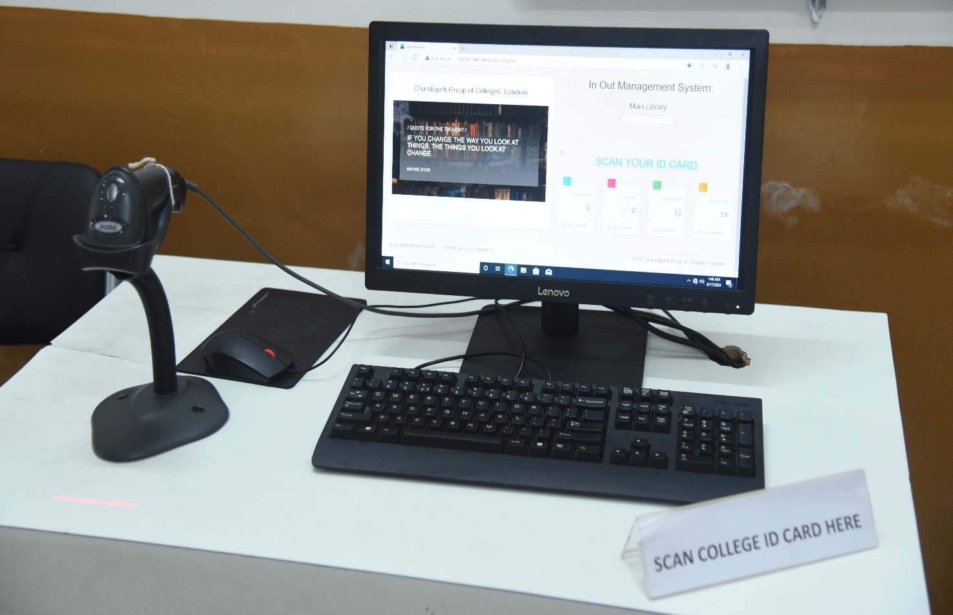
BARCODE SCANNED ENTRY/EXIT
Since the ID cards are scanned to keep track of entry and exit, foot traffic in the library is computerized. Students scan their ID cards as they enter or leave the library using the barcode scanner.

Slide 33
LIBRARY FOOTFALL
SR.NO | YEAR | FOOTFALL
1 | 2025-2026 | 8457
2 | 2024-2025 | 7456
3 | 2023-2024 | 6482
4 | 2022-2023 | 5943
5 | 2021-2022 | 5240

Slide 34
ONLINE CATALOGUE (OPAC)
The facility to search the open public access catalogue (OPAC) is open to all the users over the campus-wide LAN at the URL: https://cgcopac.lsease.in/. 1 pc in the library are exclusively dedicated to OPAC search to facilitate the users.

Slide 35
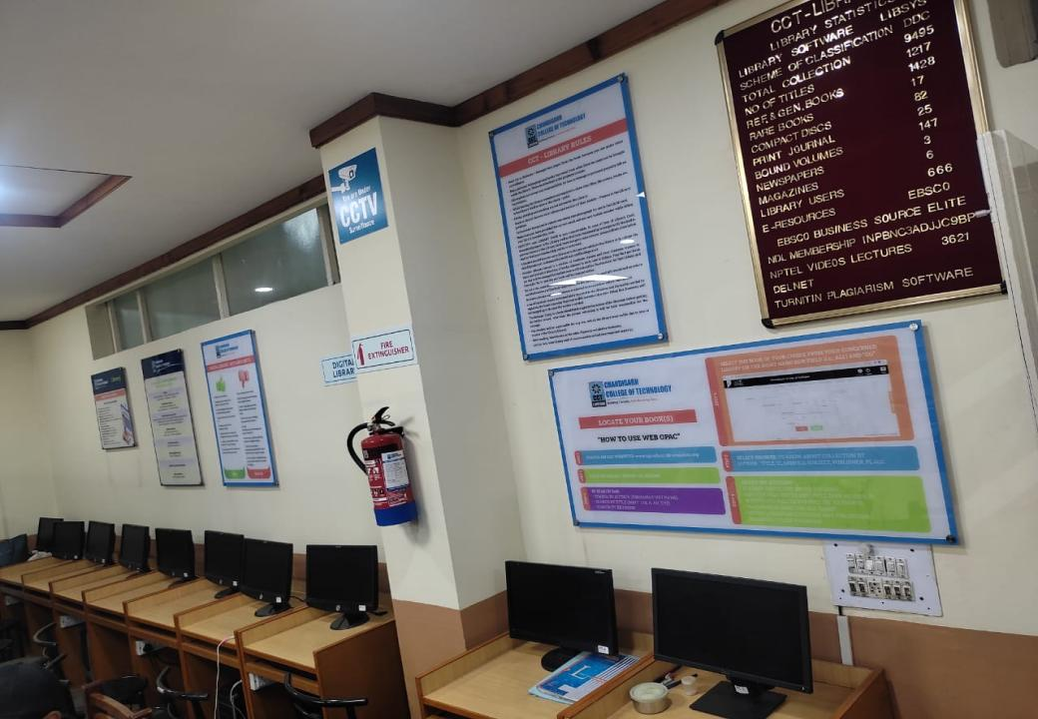
DIGITAL LIBRARY
THE LIBRARY INTENDS TO HAVE A WELL-DEVELOPED COMPUTER AND NETWORK INFRASTRUCTURE IN THE FORM OF A DIGITAL LIBRARY WITH A PROVISION OF 10 COMPUTERS TO FACILITATE THE USE OF ALL THE WEB-BASED RESOURCES AND SERVICES SUBSCRIBED

Slide 36
WI-FI FACILITY
STUDENTS & FACULTY CAN ACCESS THE INTERNET WITHIN LIBRARY PREMISES ON THEIR LAPTOPS AND MOBILES AS THE LIBRARY IS WI-FI ENABLED.

Slide 37
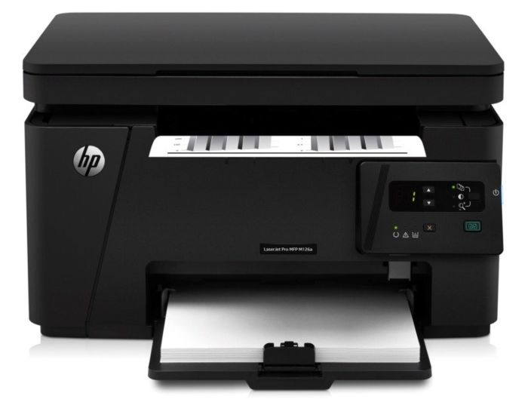
REPROGRAPHIC SERVICE
THE LIBRARY FACILITATES ITS USERS BY PROVIDING REPROGRAPHIC SERVICE FOR GETTING THE REQUIRED MATERIAL PHOTOCOPIED. THE LIBRARY ALSO HAS A SCANNING FACILITY AVAILABLE WITHIN THE LIBRARY PREMISES.

Slide 38
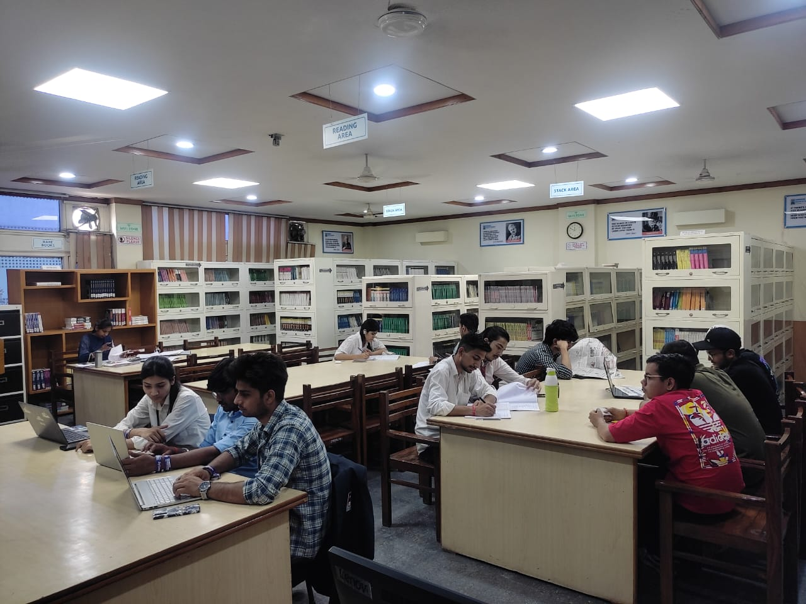
READING HALL FACILITY
The library provides its users with a conducive atmosphere with ample seating capacity .

Slide 39
CCTVs in CCT Library
2 CCTVs are installed in THE Library for 24hr. Surveillance

Slide 40
INDUCTION PROGRAMME FOR FRESHERS (SESSION 2025-2026)

Slide 41
STREAMWISE COLLECTION OF
LIBRARY
SR.NO | COURSE | TITLE | VOLUME
1 | BBA | 185 | 1167
2 | BCA | 546 | 4838
3 | BSC.MICROBIOLOGY | 43 | 114
4 | BSC.MULTIMEDIA | 58 | 102
5 | BSC.NON MEDICAL | 98 | 398
6 | BSC.GRAPHICS & WEB DESIGN | 63 | 302
7 | BSC.BIOTECHNOLOGY MSC.BIOTECHNOLOGY | 395 | 2988

Slide 42
LOCATION OF BOOKS : SUMMARY
SR.NO | BOOKCASE NO | SUBJECT NAME
1 | 1 | MULTIMEDIA ALL SUBJECT BOOKS
2 | 2 TO 6 | RESEARCH METHODOLOGY, SYSTEM PROGRAMMING, OPERATING SYSTEMS
3 | 7 TO 10 | C & C++VISUAL BASIC
4 | 11 TO 15 | JAVA, UNIX, DATA COMMUNICAION AND NETWORKING, COMPUTER NETWORKS, DATABASE SYSTEMS
5 | 16 TO 19 | DATABASE SYSTEMS, DATA MINING, DATA STRUCTURES
6 | 20 TO 24 | COMPUTER GRAPHICS, PYTHON, LINUX, UNIX, ANDRIOD, HTML/DHTML, PL/SQL, PHP, CRYPTOGRAPHY NETWORK SECURITY
7 | 25 TO 28 | CLOUD COMPUTING, MANAGERIAL ECONOMICS, BUSINESS LAW
8 | 29 TO 33 | MATHEMATICS, BUSINESS STATISTICS, PHYSICS, CHEMISTRY, COMPUTER ARCHITECTURE SYSTEMS
9 | 34 TO 37 | MODERN DIGITAL ELECTRONICS, BASIC ACCOUNTING, COST ACCOUNTING, FINANCIAL ACCOUNTING, COPORATE ACCOUNTING, BUSINESS ENVIORONMENT
10 | 38 TO 42 | HUMAN RESOURCE MANAGEMENT, MARKETING MANAGEMENT, DIGITAL MARKETING
11 | R1 TO 7 | REFERENCE BOOKS
12 | R8 | BOUND VOLUMES

Slide 43
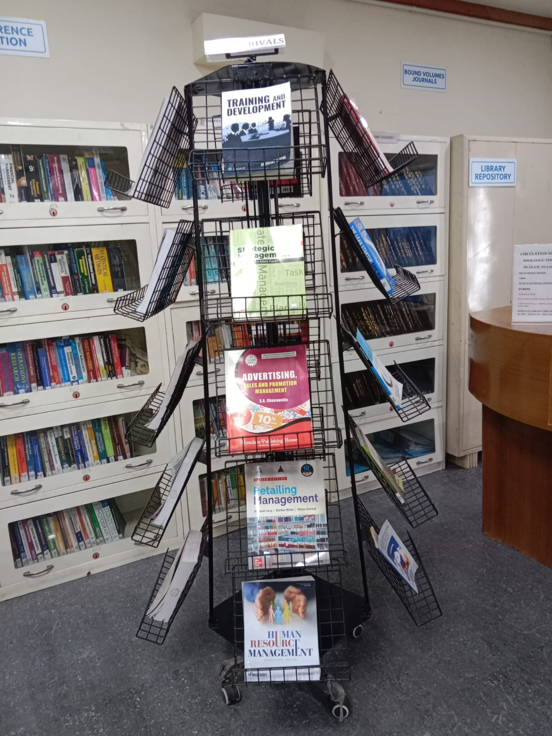
DISPLAY OF NEW ARRIVALS

Slide 44
NEW ARRIVALS – YEAR 2025-26
Accn No | Title | Author | Class No | Copies
BA157-162 | TRAINING AND DEVELOPMENT | UPPAL, NISHANT | 658.3124 U121T | 6
BA163-167 | HUMAN RESOURCE MANAGEMENT | DESSLER, GARY AND VERKKEY, BIJU | 658.3 D475H | 5
BA168-170 | BUSINESS ENVIRONMENT | GOWDA M., RAMACHANDRA | 658 G722B | 3
BA171-175 | FINANCIAL MANAGEMENT | GUPTA,SHASHI.K | 658.15 G977F | 5
BA176-180 | ESSENTIALS OF BUSINESS ENVIRONMENT: TEXT, CASES AND EXERCISES | ASWATHAPPA, K. | 658.0954 A861E | 5
BA181-185 | SERVICES MARKETING | ZETTHAML, VALARIE A. | 658.8 Z37S | 5
BA186-190 | RETAILING MANAGEMENT | LEVY,MICHAEL | 658 L668R | 5
BA191-197 | CROSS-CULTURAL MANAGEMENT TEXT AND CASES | BHATTACHARYYA, DIPAK KUMAR | 658 B311C | 7
BA198-202 | STRATEGIC MANAGEMENT | KAZMI, AZHAR. | 658.4012 K23S | 5
BA203-207 | BHARAT, S COMPANY LAW PROCEDURES & COMPLIANCES VOL-1 | GUPTA, DR. SANJEEV | 347.7 G977B | 5
BA208-212 | BHARAT, S COMPANY LAW PROCEDURES & COMPLIANCES VOL-2 | GUPTA, DR. SANJEEV | 347.7 G977B | 5
BA213-215 | ENTREPRENEURIAL DEVELOPMENT POTENTIAL BEYOND BOUNDARIES | DESAI, VASANT | 6588.421 D441E | 3
BA216 | KIND WORDS FOR UNKIND DAYS | HARDY, JAYNE | 158.1 H268K | 1

Slide 45
BA217 | RADHA THE PRINCESS OF BARSANA | NEELIMA | 823 N378R | 1
BA218 | BLUE OCEAN STRATEGY | KIM, W. CHAN | 158.1 K491B | 1
BA219 | THE LEAN STARTUP | RIES, ERIC | 658.11 R559L | 1
BA220 | THINKING, FAST AND SLOW | KAHNEMAN, DANIEL | 153.42 K12T | 1
BA221 | THE INTELLIGENT INVESTOR | GRAHAM, BENJAMIN | 332.678 G739I | 1
BA222-223 | BUSINESS ETHICS AND CORPORATE SOCIAL RESPONSIBILITY | KHANKA, S.S. | 174.4 K45S | 2
BA224-225 | BUSINESS ENVIRONMENT | GOWDA M., RAMACHANDRA | 658.0954 G688B | 2
BT2918-2921 | BIOSTATISTICS | ARORA,P.N. | 610.72 A769B | 4
BT2922-2926 | CODE BREAKER | DOUDNA, JENNIFER | 576.5 D728C | 5
BT2927-2930 | MERI JEEVAN YATRA: KALAM KI KAHANI, UNHI KI JUBAANI | KALAM, A.P.J. ABDUL | 920 K124M | 4
BT2931-2932 | INTRODUCTION TO INDIAN KNOWLEDGE SYSTEM: CONCEPTS AND APPLICATIONS | MAHADEVAN, B. | 305.800954 M214I | 2
BT2933-2934 | ECHOES OF ANCIENT INDIAN WISDOM | NAIR, SHANTHA N. | 304.420954 N158E | 2
BT2935-2937 | RASIDI TICKET | PRITAM, AMRITA | 891.42 P939R | 3
BT2938 | WE NEED TO TALK | HEADLEE, CELESTE | 153.6 H433W | 1
BT2939-2941 | PRACTICING MIND | STERNER, THOMAS M. | 153.53 S839P | 3
BT2942-46 | ENVIRONMENTAL STUDIES SIMPLIFIED | JOSEPH, BENNY | 354 J83E | 5

Slide 46
BT2947-2951 | PLANT BIOTECHNOLOGY | GUPTA, P.K. | 620.8 G977P | 5
BT2952-2956 | ELON MUSK : HOW THE BILLIONAIRE CEO OF SPACEX AND TESLA IS SHAPING OUR FUTURE | VANCE, ASHLEE | 920.082 V222E | 5
BT2957 | BIOINFORMATICS AND FUNCTIONAL GENOMICS | PEVSNER, JONATHAN | 572.80285 P338B | 1
BT2958-2959 | WE NEED TO TALK | HEADLEE, CELESTE | 153.6 H433W | 2
BT2960-2962 | FIVE STARS | GALLO, CARMINE | 658.4 G172F | 3
BT2963 | BIOSTATISTICS | ARORA,P.N. | 610.72 A769B | 1
BT2964-2968 | PRINCIPLES AND TECHNIQUES OF BIOCHEMISTRY AND MOLECULAR BIOLOGY | WILSON | 574.192 W699P | 5
BT2969-2973 | ENGLISH FOR TECHNICAL PROFESSIONALS WITH LAB MANUAL | KUMAR, KULBHUSHAN | 651.75 K96E | 5
BT2974-2978 | IMMUNOLOGY AND IMMUNOTECHNOLOGY | GHOSH, SHYAMASREE | 616.078 G427I | 5
BT2979-2983 | TEXTBOOK OF PHYSICAL CHEMISTRY: THERMODYNAMICS AND CHEMICAL | KAPOOR, K. L. | 541 K17T | 5
BT2984-2988 | TEXTBOOK OF IMMUNOLOGY: INCLUDING IMMUNOTECHNOLOGY AND IMMUN | PAUL, AJOY | 616.078 P324T | 5
CA4708-4714 | DATA STRUCTURES USING C | THAREJA,REEMA | 005.73 T367D | 7
CA4715-4721 | OPERATING SYSTEM CONCEPTS | SILBERSCHATZ,ABRAHAM | 001.642 S32O | 7
CA4722-4728 | THE LEAN STARTUP | RIES, ERIC | 658.11 R559L | 7
CA4729-4735 | MODERN OPERATING SYSTEMS | TANENBAUM,ANDREW S. | 001.642 T154M | 7
CA4736-4745 | FUNDAMENTALS OF DIGITAL MARKETING | BHATIA,PUNEET SINGH | 658.80285 B575F | 10
CA4746-4750 | MACHINE LEARNING | NAIK T., HARISHA | 005.31 N155M | 5
CA4751-4755 | OBJECT-ORIENTED PROGRAMMING WITH C++ | BALAGURUSAMY, E. | 001.6424 B188O | 5
CA4756-4765 | A BOOK OF ANDROID PROGRAMMING | KHAN, AJMAL KAMIL | 005.1 K527A | 10

Slide 47

DIFFERENT SECTIONS OF LIBRARY
ENTRY/EXIT GATE
PROPERTY COUNTER
WEBOPAC SECTION
ACQUISITION SECTION
TECHNICAL SECTION
REFERENCE SECTION
RARE BOOK SECTION
CIRCULATION SECTION
PG COURSES SECTION
PERIODICAL SECTION
BOUND VOLUMES SECTION
BOOK BANK SECTION
DIGITAL LIBRARY SECTION
REPROGRAPHIC SECTION

Slide 48
ACQUISITION SECTION
NO.OF TITLES/VOLUMES ADDED- LAST 4 YEARS GROWTH

Slide 49
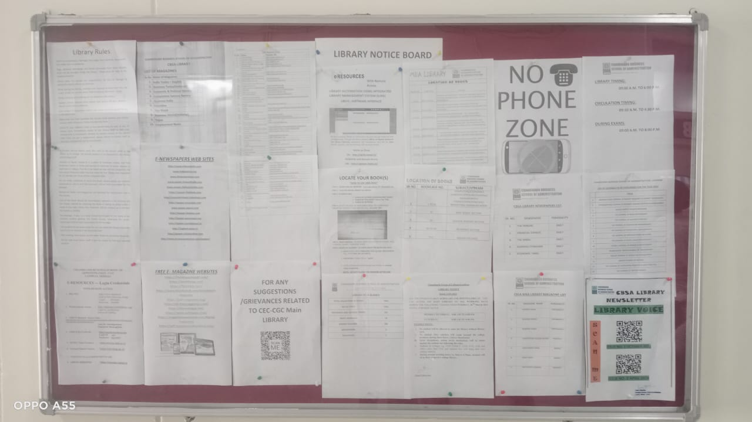
LIBRARY NOTICE BOARD

Slide 50
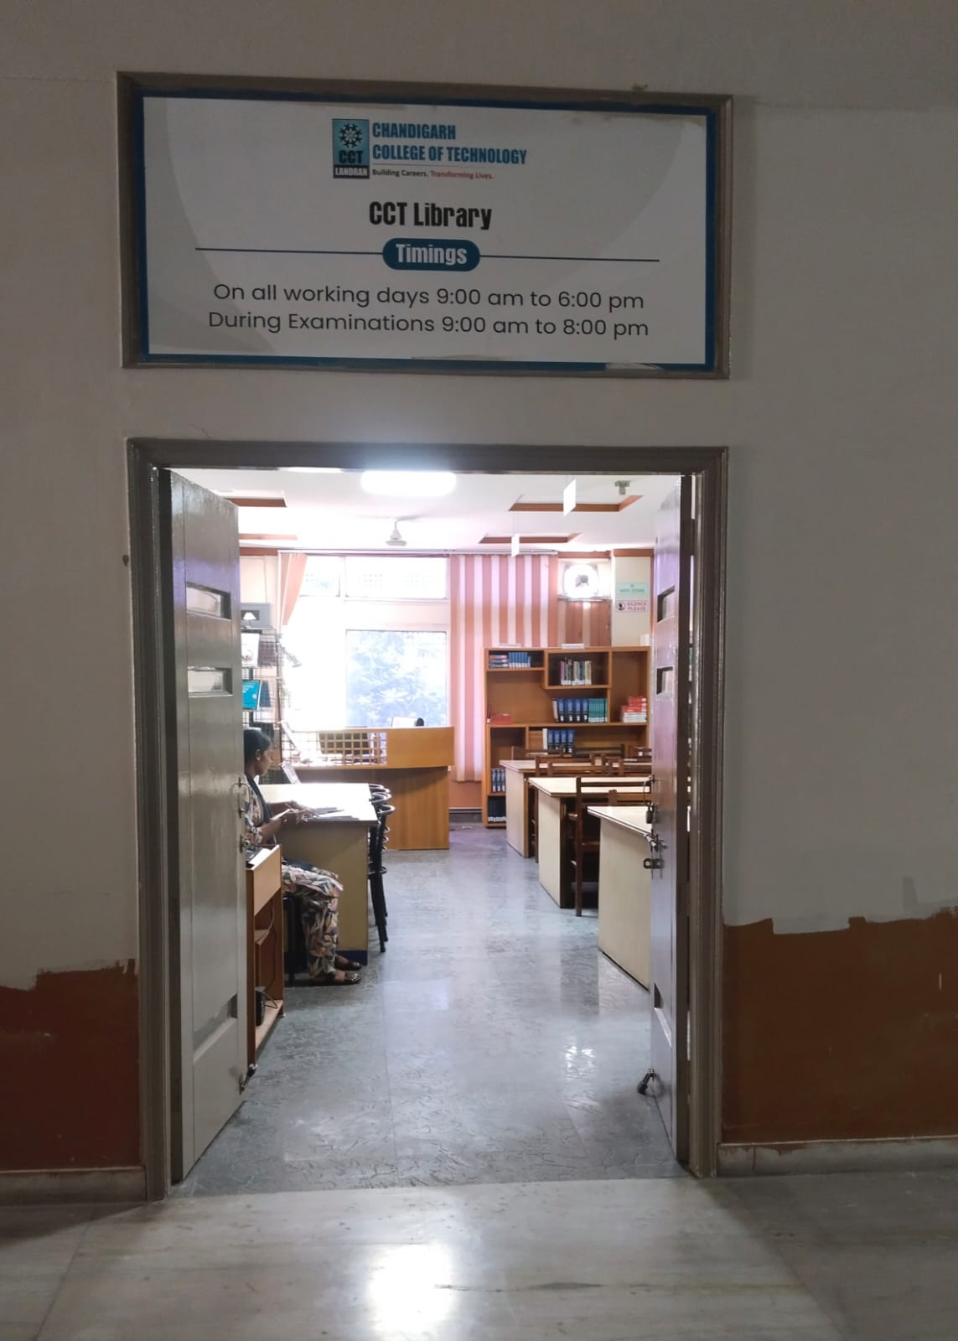
ENTRY / EXIT GATE

Slide 51
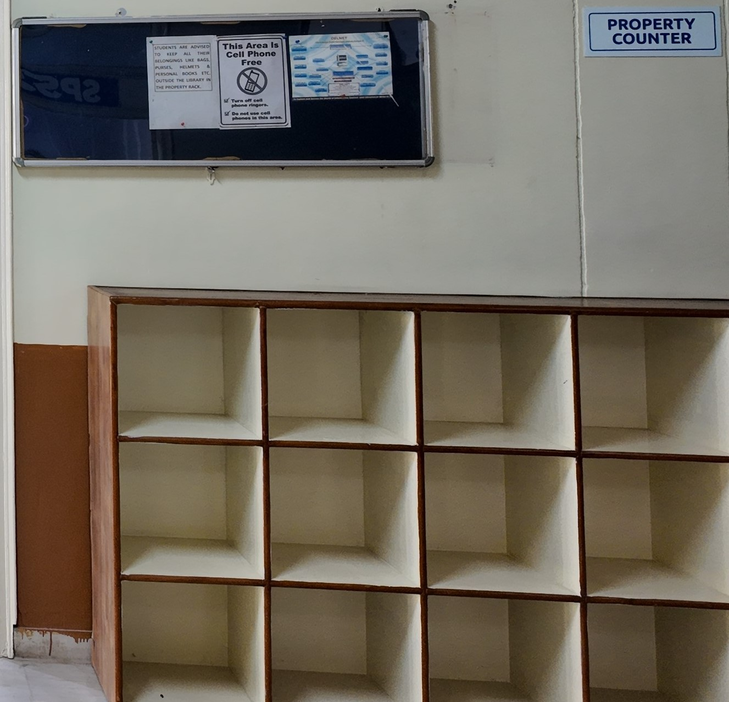
PROPERTY COUNTER

Slide 52
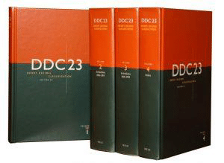
TECHNICAL SECTION
FOR INFORMATION STORAGE & RETRIEVAL, PROPER CLASSIFICATION & CATALOGUING OF EACH DOCUMENT IS DONE. LIBRARY IS USING DEWEY DECIMAL CLASSIFICATION (DDC) FOR CLASSIFICATION OF ITS DOCUMENTS

Slide 53
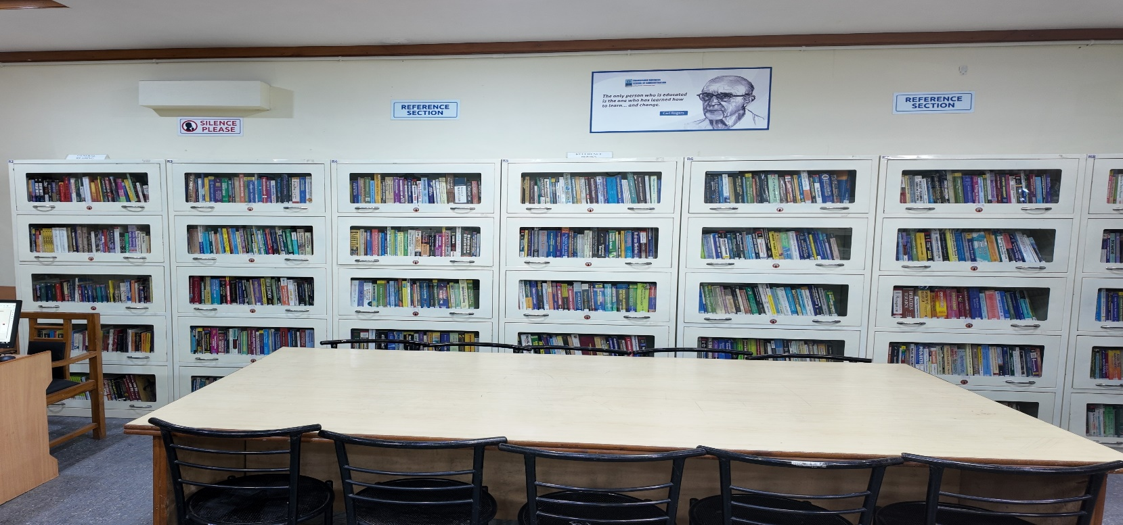
REFERENCE SECTION

Slide 54
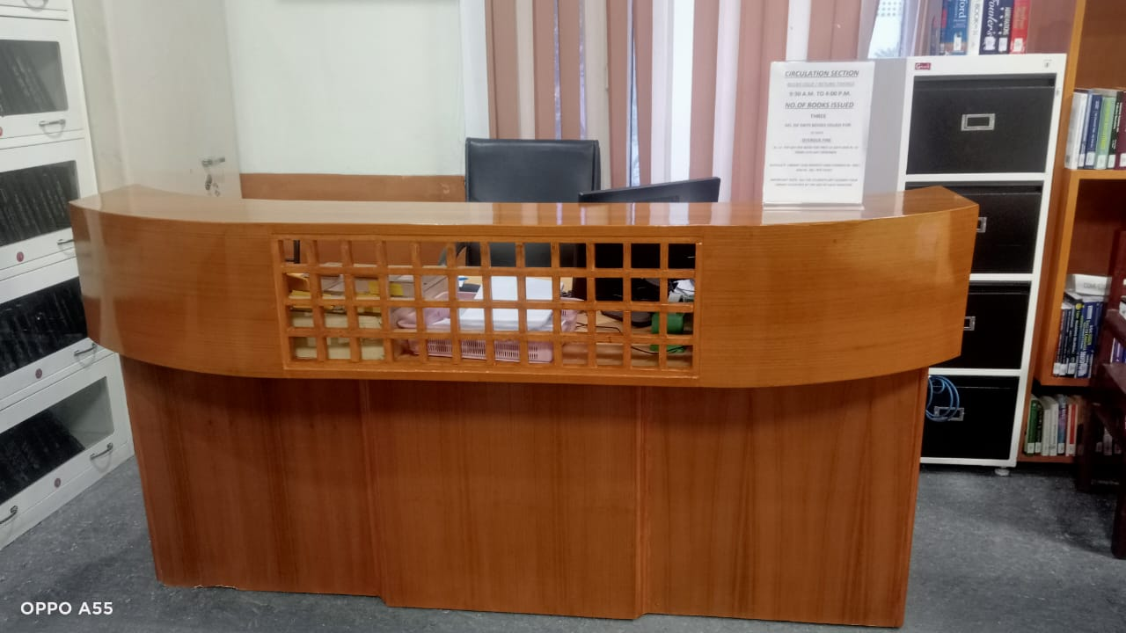
CIRCULATION SECTION

Slide 55
CIRCULATION SCHEDULE
NUMBER OF BOOKS ISSUED TO EACH STUDENT 3 BOOKS
PERIOD OF RETENTION 21 DAYS
MERITORIOUS/SC STUDENTS GET 2 BOOKS EXTRA
CIRCULATION TIMINGS
9:30 am to 4:30 pm
IMPORTANT: ALL THE STUDENTS GET CLEARED THEIR LIBRARY ACCOUNTS AT THE END OF EACH SEMESTER

Slide 56
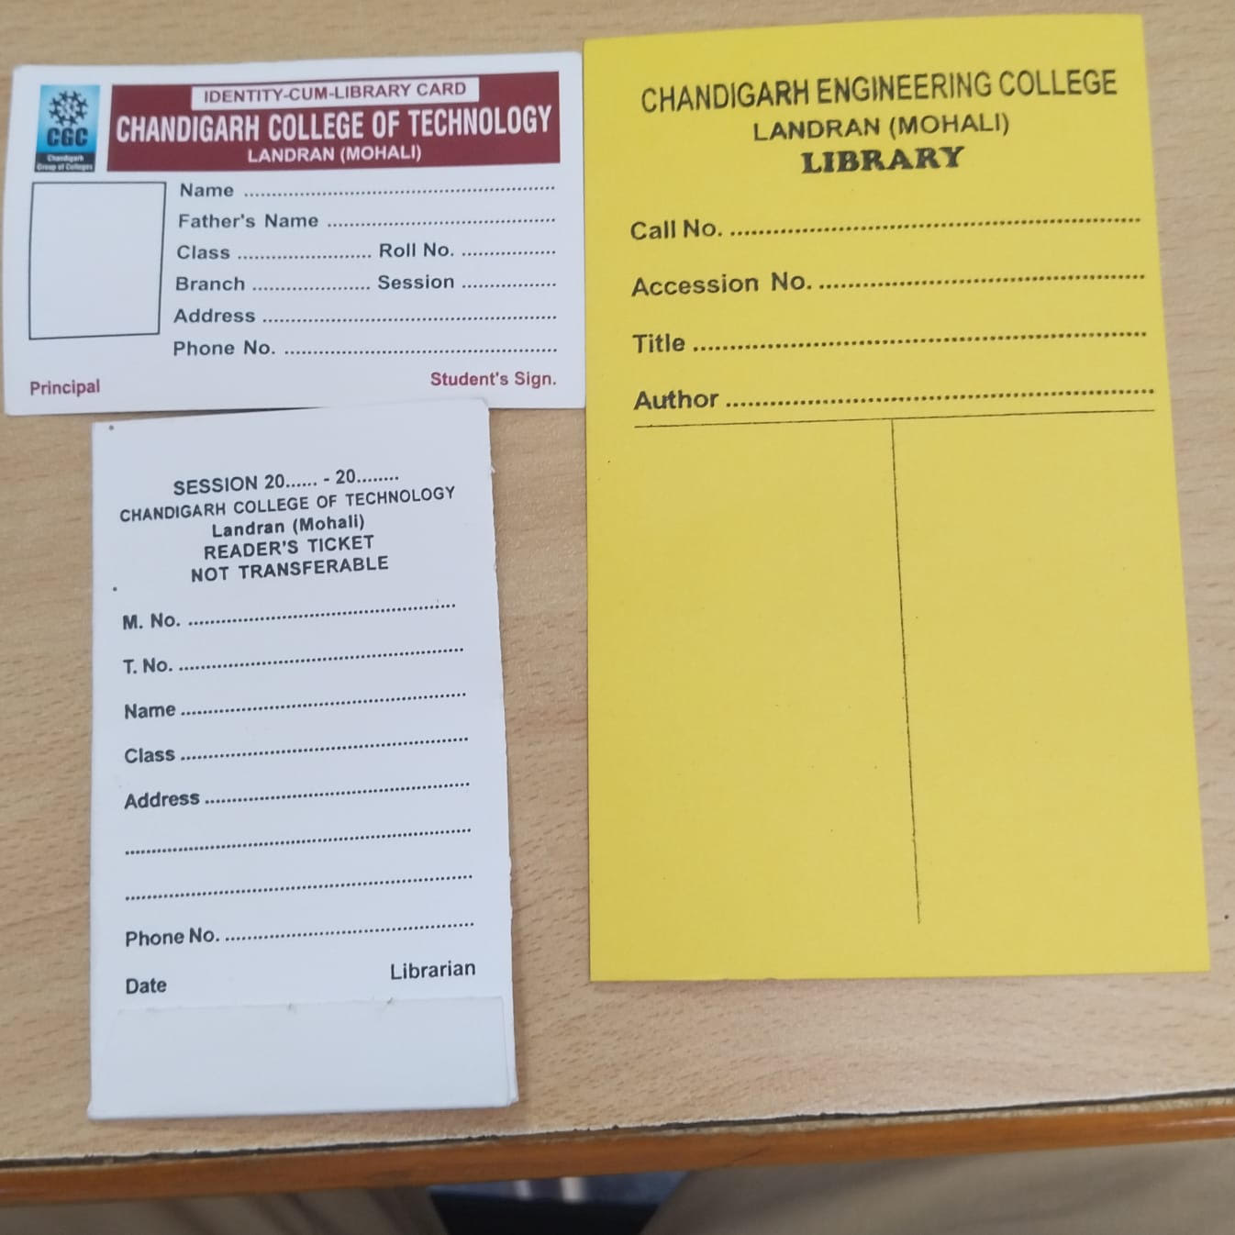
SPECIMEN : STUDENTS’ LIBRARY CARD AND TICKETS

Slide 57
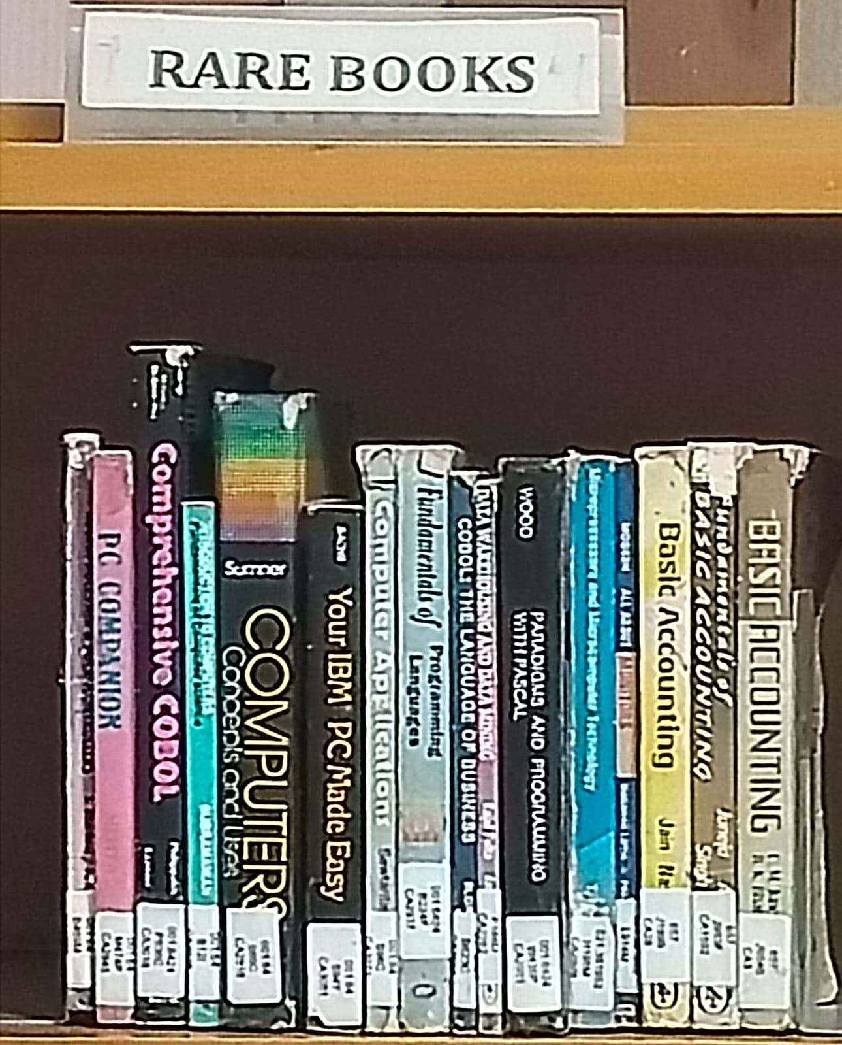
RARE BOOKS SECTION

Slide 58
STACK AREA

Slide 59
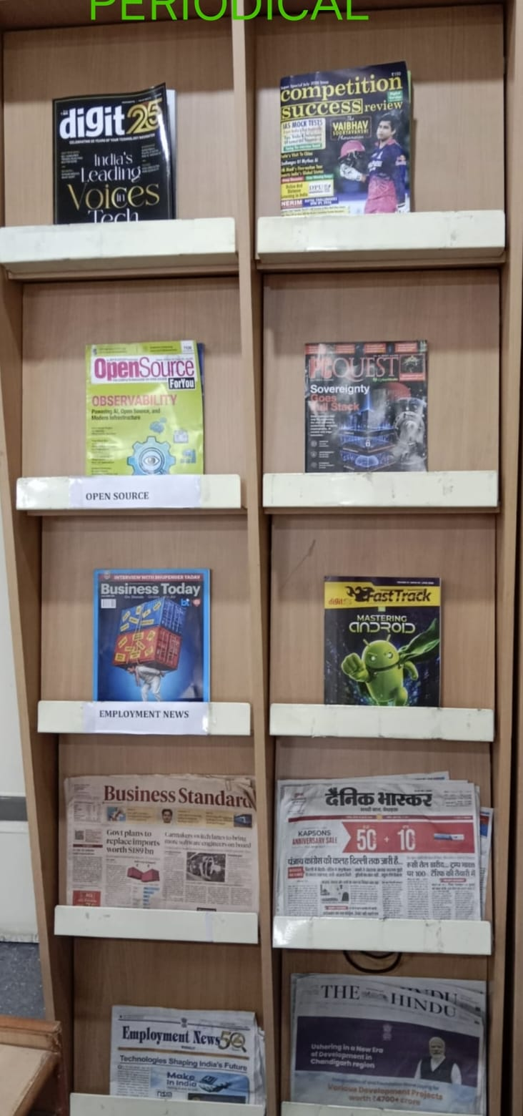
PERIODICAL SECTION
LIBRARY SUBSCRIBES TO 25 PRINT JOURNALS, 6 MAGAZINES AND 3 NEWSPAPERS

Slide 60
SR. NO. | JOURNALS
1 | INTERNATIONAL JOURNAL OF BIOTECHNOLOGY and BIOCHEMISTRY
2 | ASIAN JOURNAL OF MICROBIOLOGY, BIOTECHNOLOGY AND ENVIRONMENTAL SCIENCES
3 | JOURNAL OF CANCER RESEARCH & THERAPEUTICS
4 | SCIENXT JOURNAL OF BIOTECHNOLOGY & LIFE SCIENCES
5 | SCIENXT JOURNAL OF MICROBIOLOGY
6 | GLOBAL JOURNAL OF PURE & APPLIED MATHEMATICS
7 | INTERNATIONAL JOURNAL OF PURE & APPLIED PHYSICS
8 | JOURNAL OF ANDROID AND IOS APPLICATIONS AND TESTING
9 | JOURNAL OF NEW TRENDS IN ROBOTICS & AUTOMATION
10 | JOURNAL OF INFORMATION TECHNOLOGY AND SCIENCES
11 | JOURNAL OF NETWORK SECURITY COMPUTER NETWORKS
12 | INVENTI IMPACT ENGINEERING MATHEMATICS
13 | JOURNAL OF WEB DEVELOPMENT AND WEB DESIGNING
14 | INTERNATIONAL JOURNAL OF BUSINESS ADMINISTRATION & MANAGEMENT
15 | GLOBAL JOURNAL OF FINANCE & MANAGEMENT
16 | INTERNATIONAL JOURNAL OF CUSTOMER RELATION MANAGEMENT
17 | INTERNATIONAL JOURNAL OF HUMAN RESOURCE MANAGEMENT
18 | IUPJOURNAL OF BANK MANAGMENT
19 | JOURNAL OF COMPUTER SCIENCE & APPLICATIONS
20 | INTERNATIONAL JOURNAL OF ADVANCED COMPUTER SCIENCE & TECHNOLOGY
21 | GLOBAL JOURNAL OF COMPUTATIONAL INTELLIGENCE RESEARCH
22 | INDIAN JOURNAL OF WIRELESS NETWORKS & COMMUNICATIONS
23 | INDIAN JOURNAL OF COMPUTER SCIENCE :THEORY & PRACTICAL
24 | JOURNAL OF INTELLIGENT DATA ANALYSIS & COMPUTATIONAL STATISTICS
25 | JOURNAL OF ARTIFICIAL INTELLIGENCE RESEARCH & ADVANCES
PRINT JOURNALS SUBSCRIBED IN
YEAR
2026

Slide 61
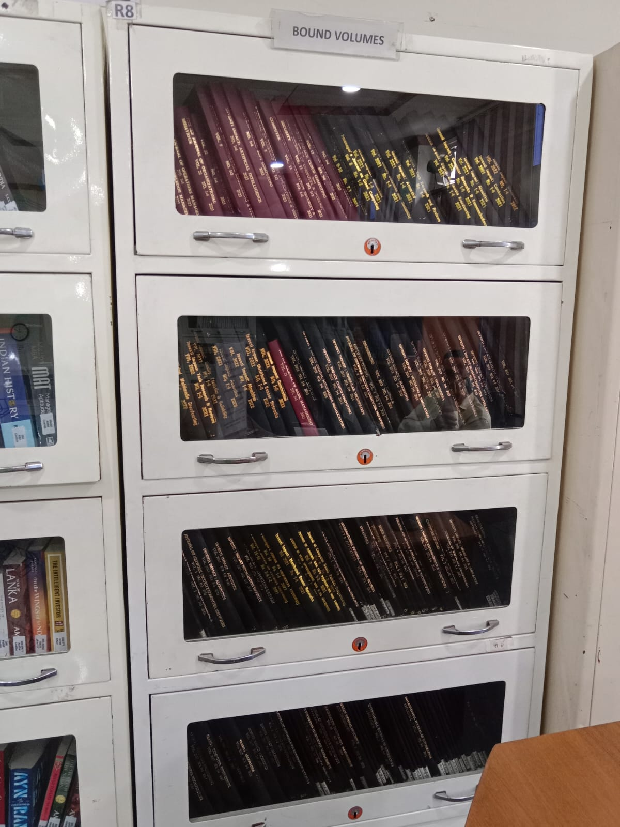
BOUND VOLUMES SECTION
JOURNALS 2007-2023

Slide 62
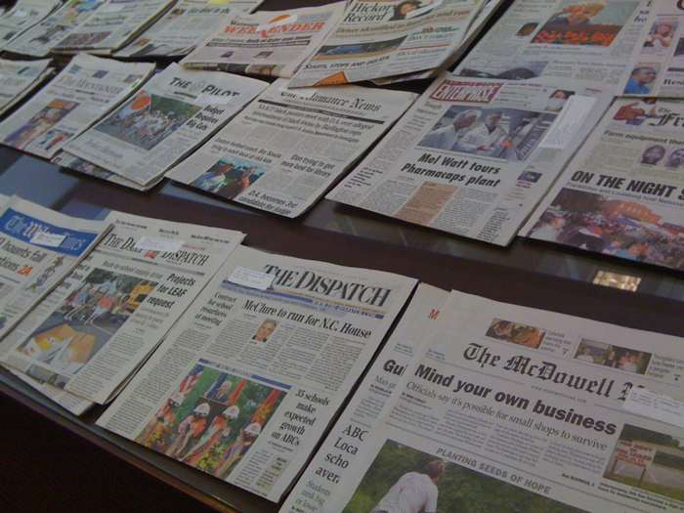

1. THE HINDU
2. BUSINESS STANDARD
3. DAINIK BHASKAR

Slide 63
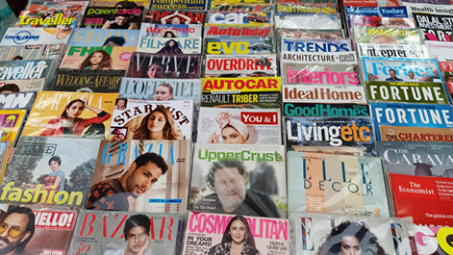
LIST OF MAGAZINES
1. COMPETITION SUCCESS REVIEW (MONTHLY)
2. DIGIT
3. PC QUEST
4. BUSINESS TODAY
5. OPEN SOURCE FOR YOU
6. EMPLOYMENT

Slide 64
CHANDIGARH COLLEGE OF TECHNOLOGY- CGC
Library Rules
All students/users must observe total silence in the library and its environs at all times
All users/students are required to scan their College/Library ID Cards while entering the library. No one will be allowed to enter the Library without ID Card.
All students must present their Library ID Cards before borrowing any library material.

Slide 65
Library Rules CONTD.
In case of loss of ID and Reader’s Tickets, the duplicate ID card with DDR will be provided against Rs. 100/- and Readers’ Tickets against Rs.20/- each.
In case any book is lost or damaged by the borrower, he/she shall replace the latest issue of the book or set of books if one volume of the set is lost, or shall pay twice the cost of the book, within a period of 15 days, with delay fine if any.
Personal Books, Bags/ belongings, eatables, and mobile phone use are not allowed inside the library. A fine of Rs.100/- may be charged from the defaulters.

Slide 66
Library Rules CONTD.
The students/users are required to maintain discipline and silence within the library premises. In case of indiscipline, the Library Membership will be cancelled.
The students/users cannot take any book, magazine, or newspaper, outside the library without permission.
The Circulation Timing will strictly be between 9:30 AM to 4:30 PM without any break, on all working days.
The students will be issued 3 books against 3 Reader’s Tickets at a time, for 21 days. The books in demand will be issued for 7 days.
All students have to return all the library books issued against their names before the start of the new semester

Slide 67

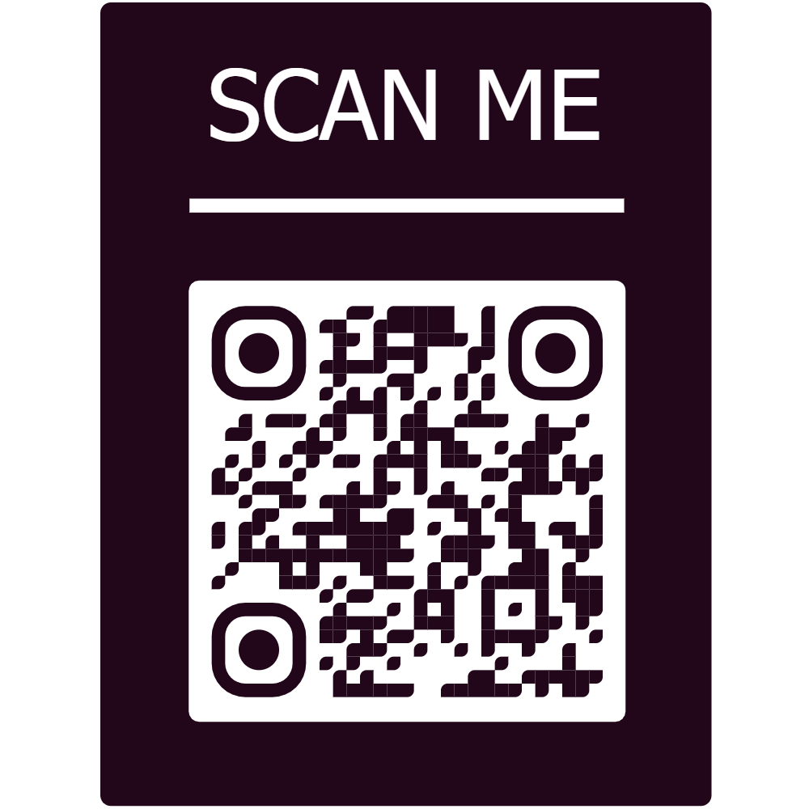
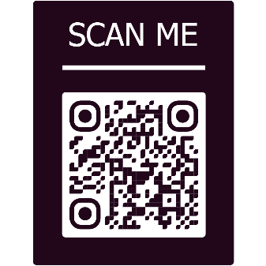
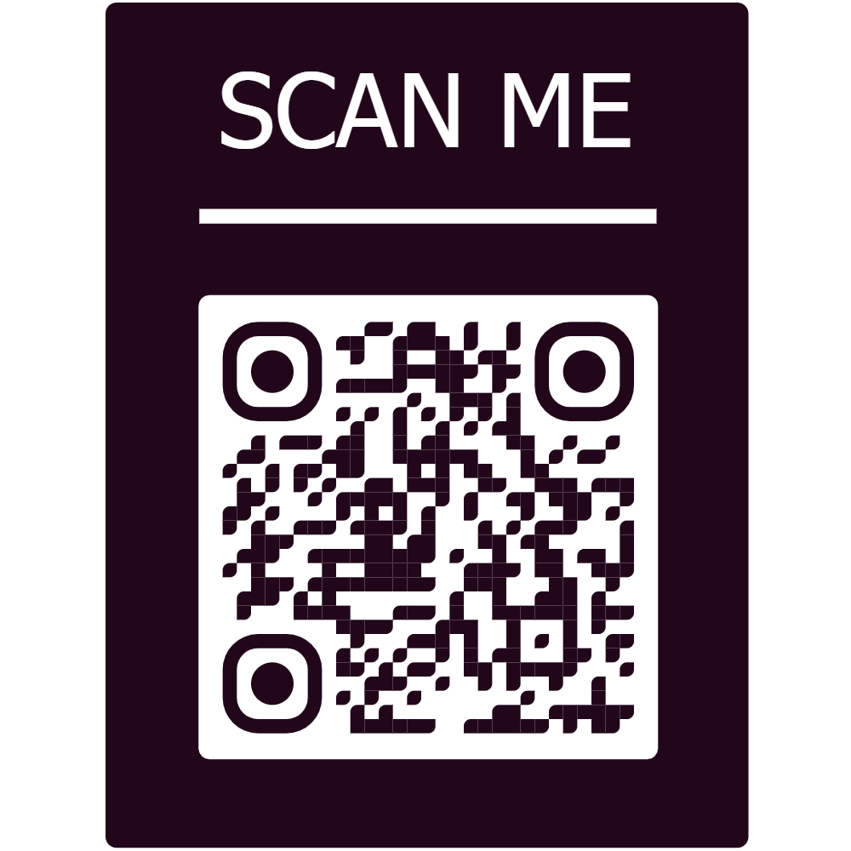
LIBRARY ECHOES
1st Issue April 2025 | 2nd Issue Sep 2025 | 3rd Issue April 2026

Slide 68

FOR ANY QUERY / SUGGESTION CONTACT :
Renu Oberoi
Chief Librarian
Chandigarh College of Technology- CGC, Landran
0172-3984229
8872014309
chief.librarian@cgc.edu.in
FOR SUGGESTIONS

Slide 69
Ready to HELP YOU
THANK YOU

